Slide 1
Current Research Areas 2
Group: Mariacher, Fritzer, Obwaller

Slide 2
Goal Day 1
Create a working lawn mower robot inside of Matlab

Slide 3
Requirements
Get the highest area coverage possible in the given time
Stay inside the lawn

Slide 4
Setup
Coding on one laptop
Others: documenting, brainstorming, drawing
Used the given files vom lecturer due to time constraints

Slide 5
Plan Day 1
Using the template from lectuerer
Detection of the area coverage
Run random walk (given) and determine starting point (area coverage)
Try to improve given random walk
Improve area coverage

Slide 6
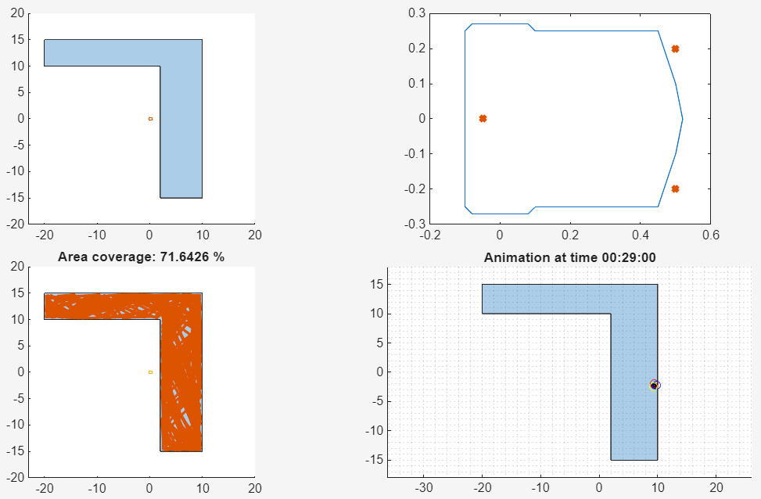
Procedure
Add area coverage to stopDemo.m

Slide 7
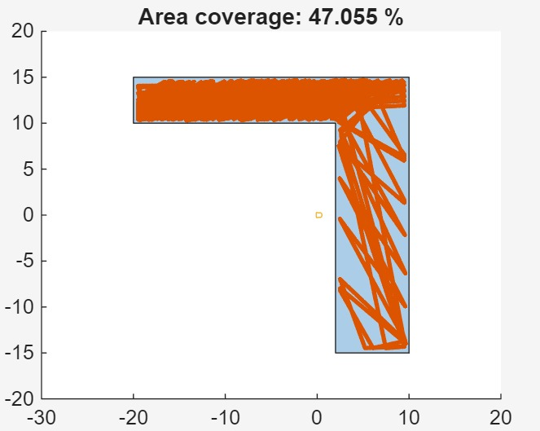
Procedure
Random walk algorithm (given)

Slide 8
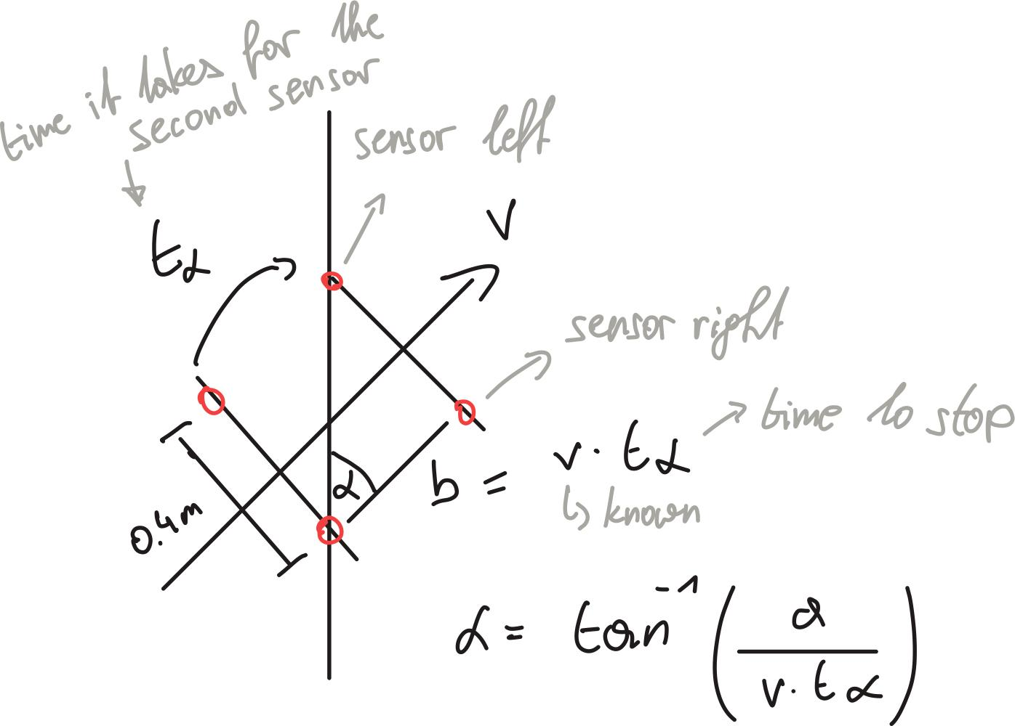
Procedure
Improve the random walk algorithm
Determination of angle (between robot and wall)

Slide 9
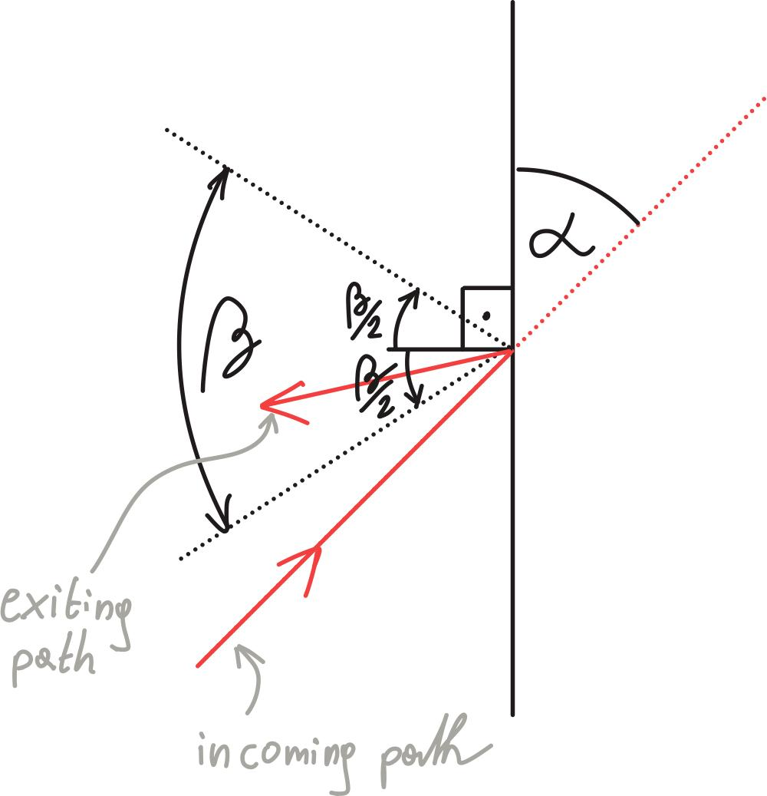
Procedure
Trying
Random return path inside the ẞ window
Turn: α + 90° ± random (0-1) * ẞ/2

Slide 10
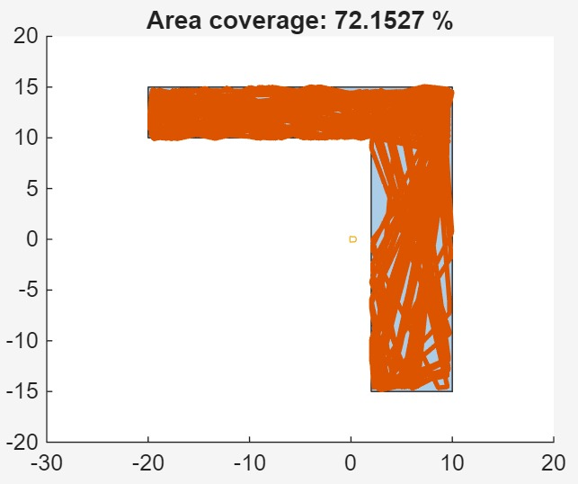
Procedure
ẞ / ° | Area coverage / %
180 | 72.1527

Slide 11
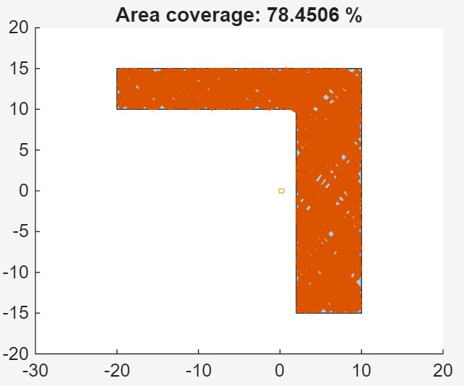
Procedure
ẞ / ° | Area coverage / %
180 | 72.1527
120 | 78.4506

Slide 12
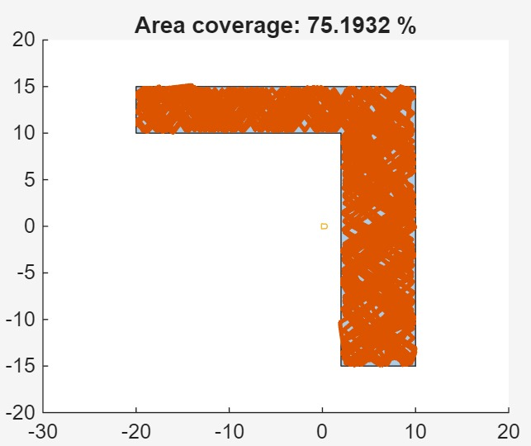
Procedure
ẞ / ° | Area coverage / %
180 | 72.1527
120 | 78.4506
90 | 75.1932

Slide 13
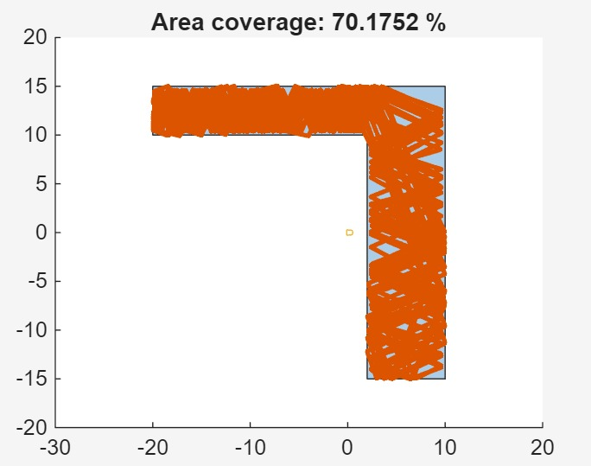
Procedure
ẞ / ° | Area coverage / %
180 | 72.1527
120 | 78.4506
90 | 75.1932
60 | 70.1752

Slide 14
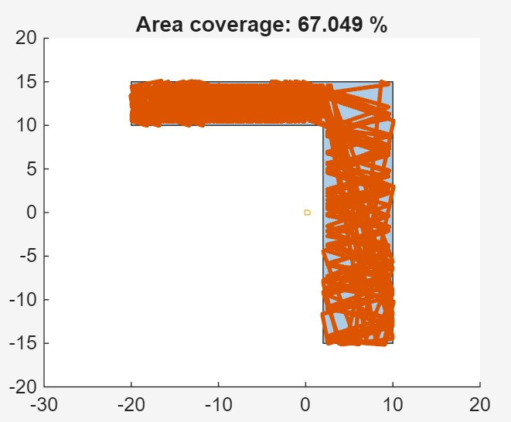
Procedure
ẞ / ° | Area coverage / %
180 | 72.1527
120 | 78.4506
90 | 75.1932
60 | 70.1752
45 | 67.0490

Slide 15
Day 2 - Agenda
Continue work from yesterday
Add safety features (all coils outside, …) (1 Person)
Improve algorithm also with AI
Find best ẞ (1 Person)
With best result add wire following (2 Persons)
Third person tries to implement mäander lines (1 Person) also with AI

Slide 16
Safety Features
Emergency-Stop when all 3 coils are outside
Not implemented features:
Multiple collision in quick succession failsafe

Slide 17
AI improvement

Slide 18
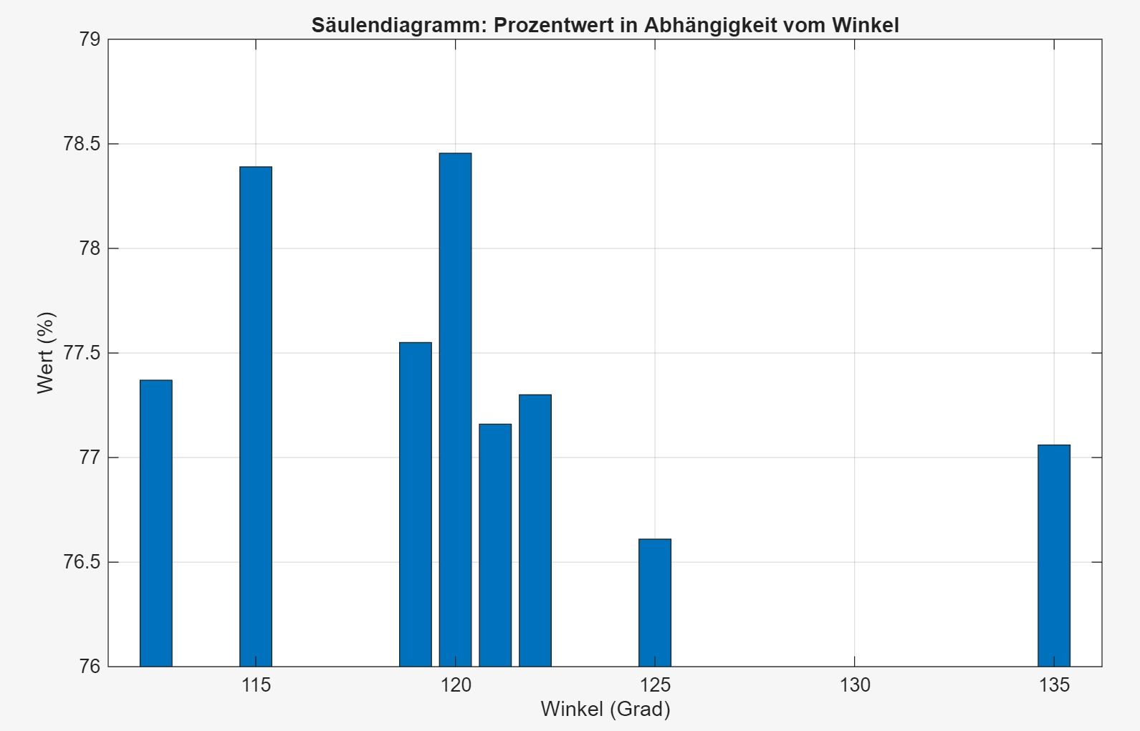
Angle variation

Slide 19
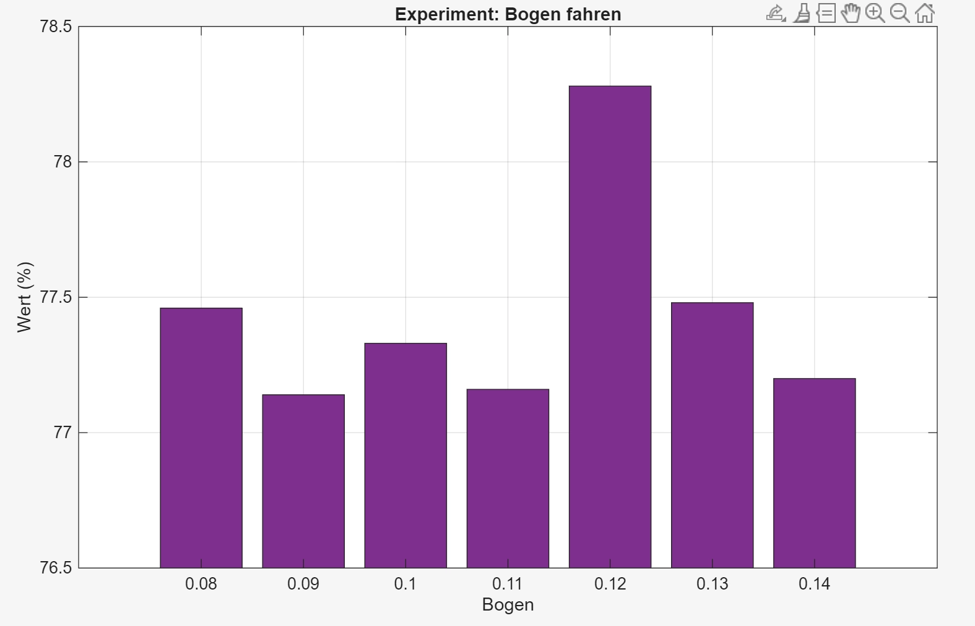
Driving a bow

Slide 20
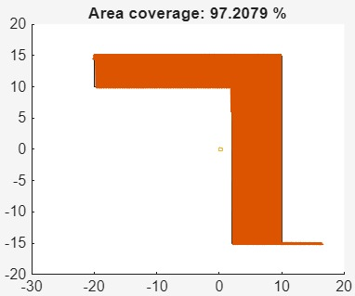
Mäander path

Slide 21
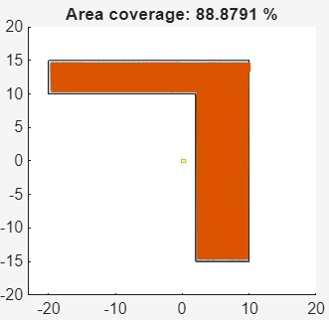
Mäander path

Slide 22
AI Usage
Gemini 3.1 PRO
Typo finding and bugfixing
Complete Mäander path
Assisting with improving the algorithm

Slide 23
Future improvements
Perimeter following
Combination of Random / Mäander and Perimeter
Investigate performance on different surface shapes

